Slide 1

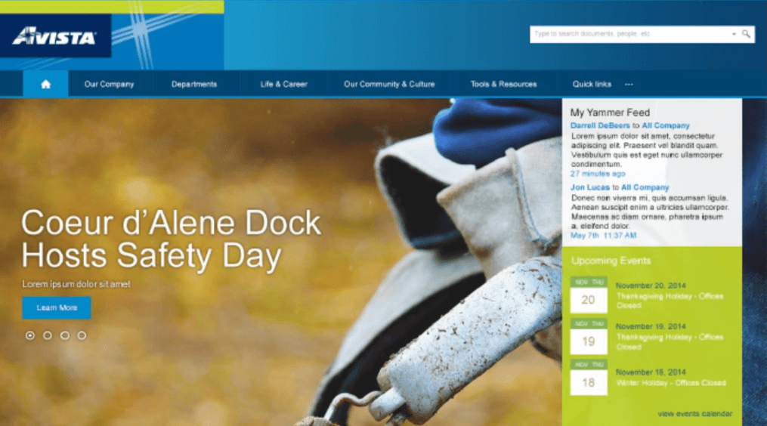
Avista Corporation Case Study
The Challenge
<p>Avista wanted to implement a new SharePoint 2016 site that encouraged participation and improved productivity on both mobile and desktop devices. Avista felt that these goals would best be accomplished with a site layout featuring intuitive navigation as well as an easy to manage content management process. Avista also wanted to integrate a search function into the site that would deliver accurate results.</p> <p>The new site would be released in two phases. The first phase would be the homepage and include hybrid search functionality. The second phase would consist of HR department pages and other department landing pages.</p>
What We Did
<p>Affirma first completed all of the necessary planning, designs and documentation.</p> <ul> <li>This included creating responsive wireframes as well as designs and employee directory requirements.</li> <li>A project plan was created, as well as technical approach documents.</li> <li>A governance document was created along with test plans with release use cases.</li> </ul> <p>Affirma then performed the implementation of the SharePoint site.</p> <ul> <li>Search functions were added and improved to ensure the delivery of quick, accurate results.</li> <li>Pages were created with mobile and tablet responsiveness to enable users to engage the site on any device.</li> <li>Global navigation with a navigation structure was created.</li> </ul> <p>Affirma then performed all necessary testing, as well as deployment, training and support.</p> <ul> <li>This included a complete internal test pass.</li> <li>Debugging posts were created, and technical knowledge transfer sessions.</li> <li>Affirma also completed 30 days of post-launch support.</li> </ul>
Results
<p>The finished site met all Avista&rsquo;s stated goals. The new site contains responsive design, intuitive navigation, and a simple and powerful content management process. Avista completed the consultation satisfied with their new completed site.</p>

Slide 2
Avista – Communications SharePoint Intranet
About Avista
Avista is one of the largest utilities providers in the Northwest, providing reliable and safe energy services to eastern Washington, Idaho and Oregon since 1889.
Avista is involved in the production, delivery and distribution of energy and energy related businesses.
The Challenge
Avista wanted to implement a new SharePoint 2016 site that encouraged participation and improved productivity on both mobile and desktop devices.
The new site would be released in two phases. The first phase would be the homepage and include hybrid search functionality. The second phase would consist of HR department pages and other department landing pages.

Slide 3
Avista – Communications SharePoint Intranet
About Avista
Avista is one of the largest utilities providers in the Northwest, providing reliable and safe energy services to eastern Washington, Idaho and Oregon since 1889.
Avista is involved in the production, delivery and distribution of energy and energy related businesses.
The Challenge
Avista wanted to implement a new SharePoint 2016 site that encouraged participation and improved productivity on both mobile and desktop devices.
The new site would be released in two phases. The first phase would be the homepage and include hybrid search functionality. The second phase would consist of HR department pages and other department landing pages.

